Slide 1


How to really use Google Notebooklm

Slide 2

"Research is what I'm doing when I don't know what I'm doing."
- Wernher von Braun

Slide 3

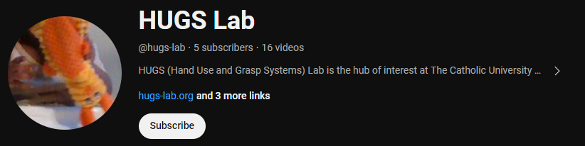

Slide 4

Getting NotebookLM

Slide 5
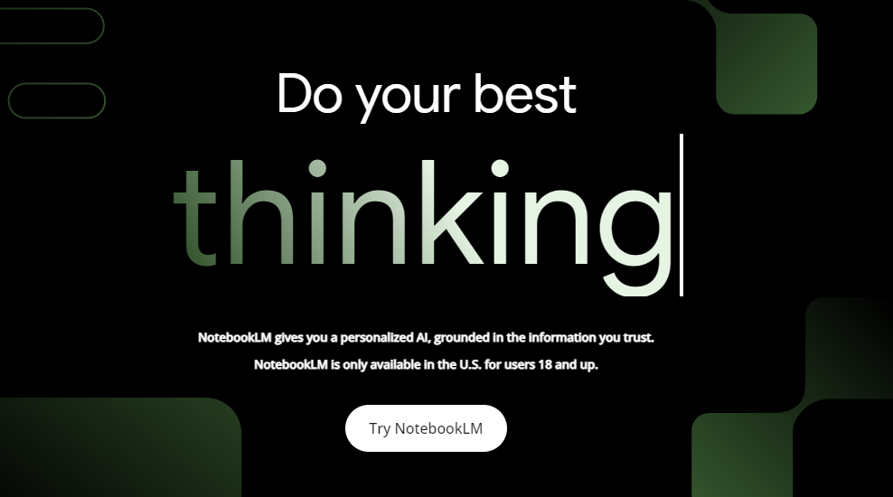
NotebookLM
Notes:
https://notebooklm.google/
https://notebooklm.google.com/

Slide 6
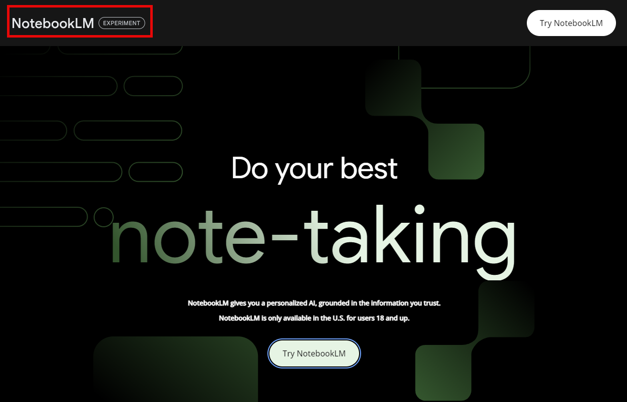
it’s experimental, so…

Slide 7

What is NotebookLM?

Slide 8
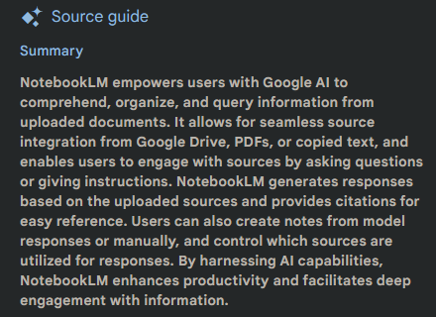

Slide 9
Notebook
Sources
Notes
Notebook
Sources
Source Guides
Citations
Source Guides
Notes
Citations

Slide 10
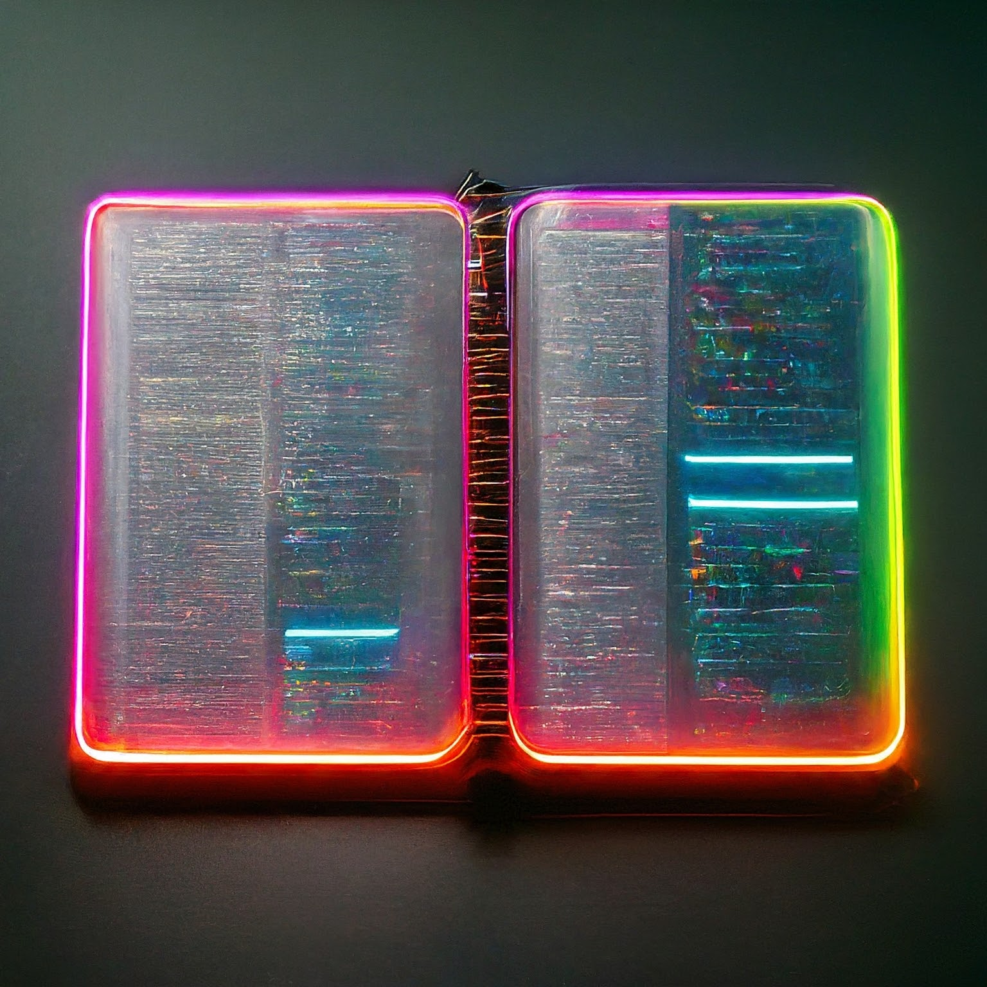
notebooks

Slide 11
Notebooks
A notebook is a tool that allows users to read, take notes, ask questions, and organize ideas with the assistance of Google AI.
Maximum 20 sources allowed
Maximum1,000 notes allowed

Slide 12
Sharing Notebooks
You can share notebooks by opening a notebook and clicking the “Share” icon in the top-right corner of the screen. You can grant either Viewer or Editor access to another user by adding their email address.
A viewer will have read-only access to all the source documents and notes you shared with them in the shared notebook
An editor will be able to view, add, or remove sources and notes in your shared notebook as well as share it further with other users

Slide 13
Serious Sharing Limitations
Personal gmail accounts and EDU accounts can share a notebook with at most 50 other individual users, and cannot share with Google Groups.
Enterprise accounts (e.g. email@mycompany.com) can share a notebook with an unlimited number of individual users and google groups.
You can only share a notebook with another user in the same domain as your account (e.g. @gmail.com, @xyz.edu).

Slide 14
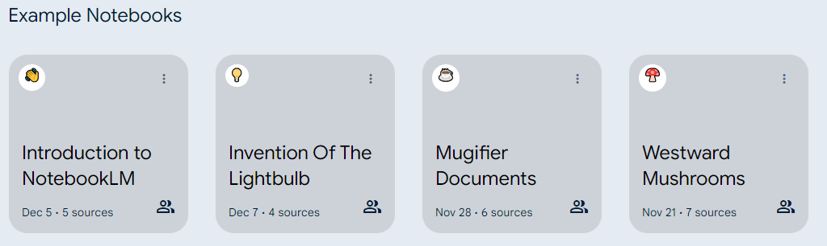
Using the Example Notebooks

Slide 15
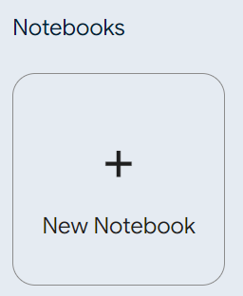
Create Your own Notebook

Slide 16

Sources

Slide 17
Sources
A source is a static copy of a Google doc you have access to, a PDF file, or text that is copied and pasted directly into the app. When using NotebookLM, the model will use the sources you upload to answer your questions or complete your requests.
NotebookLM can’t delete or edit your original files. When you upload a Google Doc or a local PDF file from your computer, the app makes a copy of the original file. NotebookLM doesn’t keep track of changes to the doc, including access to it, so you have to manually re-upload the file to refresh the content.

Slide 18
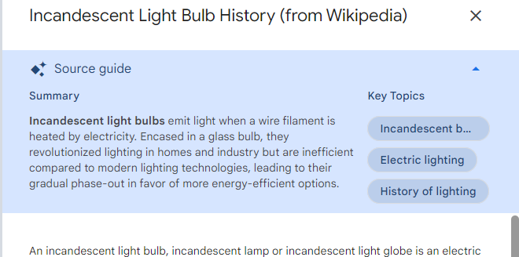
Source Guide
When you upload a new source to NotebookLM, the app instantly creates a document guide that summarizes the document and offers key topics and questions to ask. Think of it as a research assistant that helps you better understand the source material.

Slide 19
Source Limitations
Source types: Google Docs, PDF files, and copy-pasted text.
Each source can contain up to 200,000 words
Avoid uploading documents with any personal or sensitive information (e.g. names, addresses, phone numbers) in them
Avoid uploading documents you don’t have the applicable rights to
NotebookLM does not currently support images, videos, audio, or complex charts or tables
NotebookLM does not currently support version control and revision history for sources

Slide 20
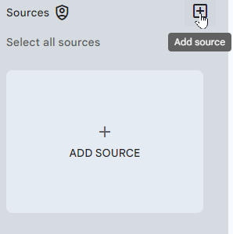
Adding Sources

Slide 21

Notes

Slide 22
Notes
You can create up to 1,000 notes per notebook
Does not currently support version control and revision history
You can save a useful response to a new note by clicking Save to notes in the upper- right corner of the response. Notes created from saved responses can’t be edited once they are created
You can save passages from your sources into a note
You can choose a variety of suggested action such as “create an outline” when you have one or more existing notes selected

Slide 23
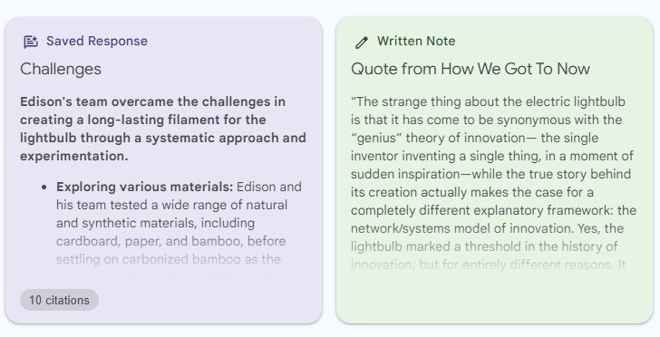
Types of notes
Saved Responses that you have captured, either chat interactions or quotes from your sources
Written Notes that you have composed yourself.

Slide 24
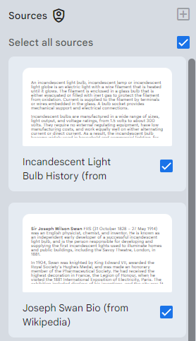
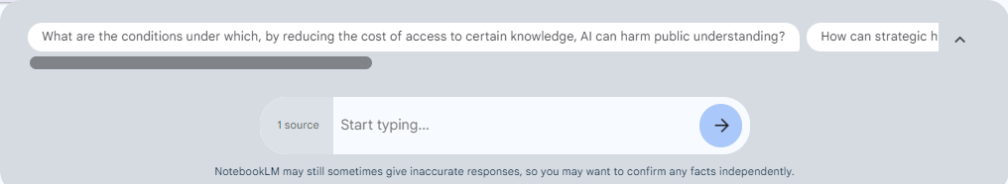
Asking Questions
Once you have uploaded your sources, you can ask the model questions about your source material or give the model instructions to perform actions.
You can use the checkbox on each source to include or exclude certain sources the model should use to answer your question in a notebook.

Slide 25
Notes Directly from the Source
You can create notes directly from the source by selecting any passage in the source and using the suggested actions, like “Summarize to note,” in order to preserve the information.

Slide 26
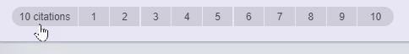
Citations
Citations are quotes from your source documents that NotebookLM uses to build its responses. Each citation is a specific block of text from your source that is considered relevant to your question. Citations are direct quotes, and seeing these passages can help you check the accuracy of the response and find the original quote.
You can hover over a citation to see the complete text quoted.
You can also click on a citation to have the source viewer auto-scroll to the location of the quoted text in the sources.

Slide 27
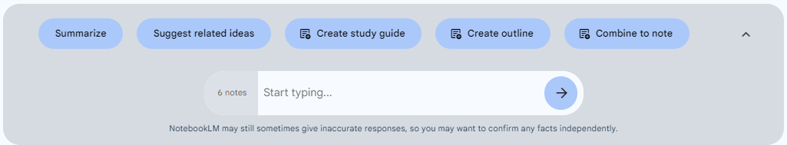
Working with Multiple Notes

Slide 28

Use Cases

Slide 29
Research Tool
NotebookLM excels at workflows that involve synthesizing information dispersed across multiple documents, which makes it a valuable tool for students, scholars, journalists, analysts, and many other "knowledge worker" professions.
If your research material involves PDFs or Google Docs, you can create a notebook for the project you're working on, and immediately add the relevant documents as sources. Within seconds, NotebookLM becomes a virtual research assistant, capable of answering questions or tracking down references based entirely on the source materials you've supplied.

Slide 30
Meeting or Interview Transcripts
NotebookLM can help you remember, summarize, and quickly find relevant passages from transcripts that you upload as sources. A documentary filmmaker or podcast producer, for instance, can use NotebookLM to store dozens of transcripts, and ask open-ended questions based on information in all of the original transcripts.
Or a financial analyst could upload the transcripts from a few years’ worth of earnings calls for a company, and ask questions like: “What did Bob Packman say about profitability in Q3 of 2022”? Or “what were the new products the CEO mentioned that they were so excited about?”

Slide 31
Help Center or Onboarding Guide
The combination of a chat interface with source grounding makes NotebookLM an excellent platform for help documentation or as a guide for new users, customers, or colleagues trying to understand a product or an organization.
Creating a help center is really just a matter of assembling documents that explain your product, service, or organization in a clear and comprehensive way. Once you’ve assembled the sources, create a notebook and upload the sources. At that point, NotebookLM will be able to answer questions based on information in those documents. You can share the Notebook with others in “Viewer” mode.

Slide 32


